Slide 1
Children’s mental health week

Slide 2
This Children’s Mental Health Week we are exploring the different ways we can express ourselves, and the creative ways that we can share our feelings, our thoughts and our ideas.
Can you write down all the activities you see which show creativity?
https://www.yout-ube.com/watch?v=rfbOkWFTRAw

Slide 3
Why does finding healthy ways to express yourself matter?
Finding creative, enjoyable ways to share our thoughts, feelings and ideas can make us feel good and help our mental health, especially when we face tough situations or a difficult time

Slide 4
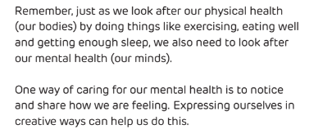
What is mental health?

Slide 5
Think back to lockdown.. What did you do to keep busy?
Lots of people found creative ways to help them through it, such as….
gardening or growing plants
mindful colouring
drawing
reading or writing stories
making models
dancing
baking
https://www.yout-ube.com/watch?v=Kl1NW7h7lrY

Slide 6
When we express ourselves we don’t have to be a great artist or a wonderful dancer. It’s not about being the very best at something or putting on a performance. Let’s encourage each other to find lots of different ways to get creative and express ourselves
https://www.yout-ube.com/watch?v=2fZjMYdQjGM

Slide 7
How can we help and support each other to get creative and express ourselves this Children's Mental Health Week?

Slide 8
The squiggle game!
https://www.yout-ube.com/watch?v=ozKW1M97JXE&feature=youtu.be

Slide 9
Origami dog!
https://www.youtube-nocookie.com/embed/dD4Gv3s3QH8?autoplay=1&iv_load_policy=3&loop=1&modestbranding=1&playlist=dD4Gv3s3QH8
Did we all have exactly the same dogs? You all came up with your own individual ways of expressing yourselves through that task!

Slide 10
Express yourselves!
I would love to see pictures of you being creative. Please encourage parents to take a picture of you and to post it on our class Facebook page or email it in.

