Slide 1
The Journey To Our School Vision
Let Your Light Shine

Slide 2
Let Your Light Shine
“In the same way, let your light shine before others that they may see your good deeds and glorify your father in heaven”
Matthew Chapter 5 Verse 16
We aim for forgiveness and reconciliation in safe surroundings. We seek experiences to spark confidence to nurture and show delight. We want to illuminate hopes, dreams and aspirations and to build humanity through relationships inspired by the glow of others. We value everyone through thoughts and actions.

Slide 3
In The Beginning…
Our Worship Group were tasked with describing the school and it’s characteristics linking to the four basic elements from The Church of England’s vision for Education, ‘Deeply Christian, Serving the Common Good’, with Jesus' promise of 'life in all its fullness' at its heart. - John 10:10
Wisdom
Hope
Community
Dignity

Slide 4
Words to describe our school…

Slide 5
Our School Community…

Slide 6
From this the most popular words and phrases were put to parents, staff and governors…
And these were the words our stakeholders thought represented SMB…
Nurturing
Inclusive
Safe
Educating
Inspiring
Family Orientated

Slide 7
Stakeholders choice of phrases representing the four basic elements…
Wisdom – to provide children with knowledge, skills and understanding
Hope – Teaching children to be confident
Community – To encourage one another
Dignity – to treat others as you would like to be treated

Slide 8
From these phrases the staff were tasked with creating the aims of SMB…
Wisdom
To seek experiences to spark the confidence to nurture and show delight
Hope
To illuminate hopes, dreams and aspirations
Community
To build humanity through relationships inspired by the glow of others
Dignity
To value everyone through thoughts and actions

Slide 9
And because our overarching value of behaviour is ‘Everyone has the right to feel safe’…
We linked this to our school prayer (The Coventry ICON School Prayer of reconciliation and came up with our first aim…
For forgiveness and reconciliation in safe surroundings

Slide 10
We then wanted a verse from the Bible to show how our aims reflected as a vision
We also wanted a verse from St Matthew to reflect our school name and looked at the following for inspiration…
Blessed are the peacemakers, for they are called the children of God Matthew 5:9
So in everything, do to others what you would have them do to you, for this sums up the law and the prophets. Matthew 7:12
Ask and it will be given to you: seek and you will find; knock the door and it will be opened to you. Matthew 7:7
In the same way, let your light shine before others that they may see your good deeds and glorify your father in heaven. Matthew 5:16

Slide 11
And we chose…
Let Your Light Shine
And then we added in the ‘shine’ words to our aims

Slide 12
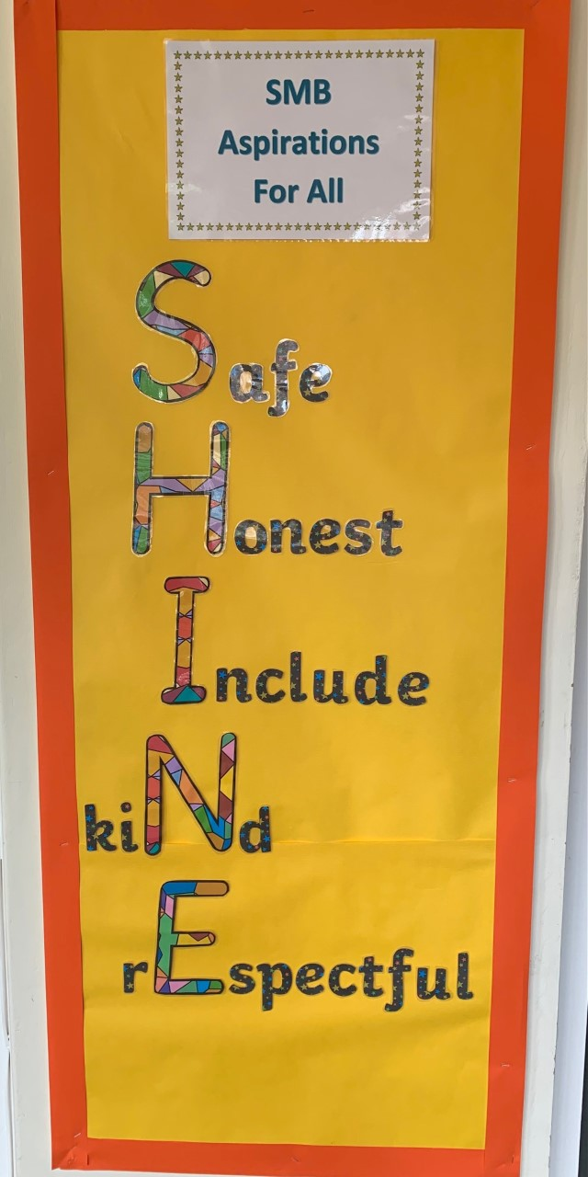
How we linked this to school rules and rewards…
We created a school code of conduct…

Slide 13



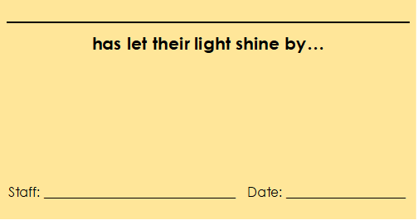

We changed our ‘Green is Great’ awards to ‘Shine Awards’…

Slide 14
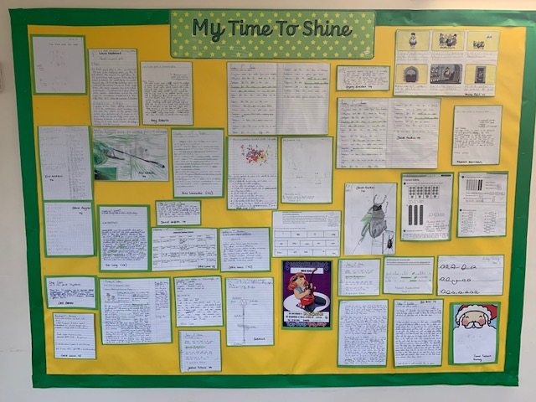
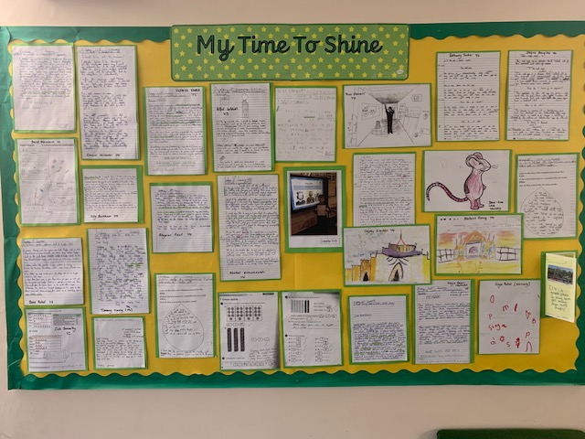
And displayed children’s shining examples of work on ‘My Time To Shine’ boards…

Slide 15

The Vision was launched in September 2019
Assemblies were focused on the book ‘The Little Soul and the Sun’

Slide 16
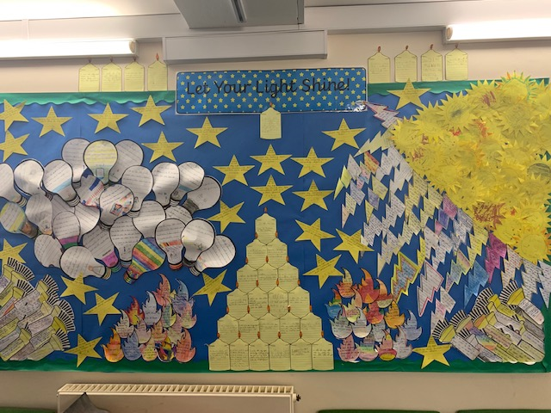
All classes wrote how they will let their light shine this year on a light source…

Slide 17
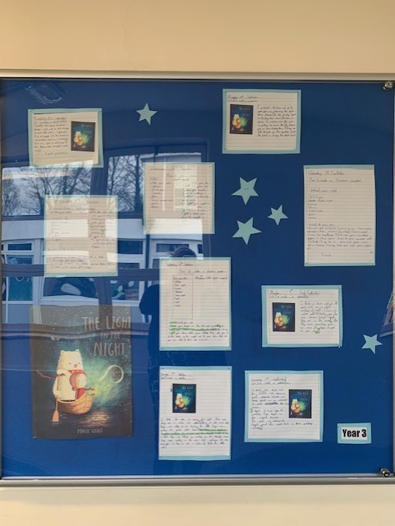
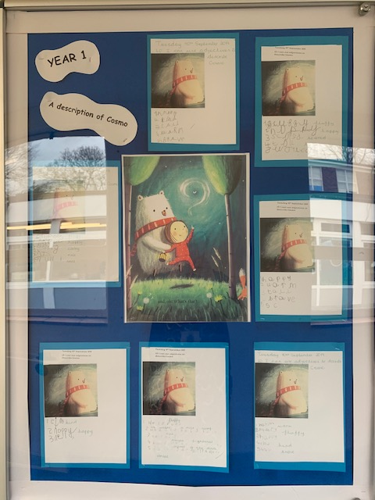
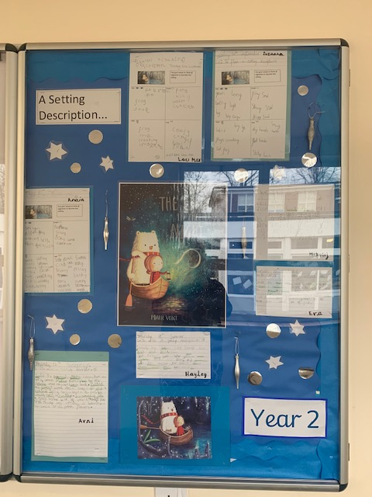
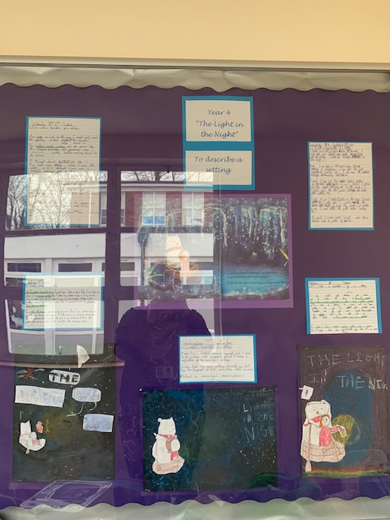
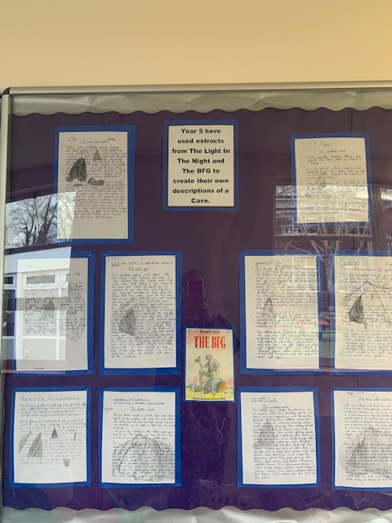
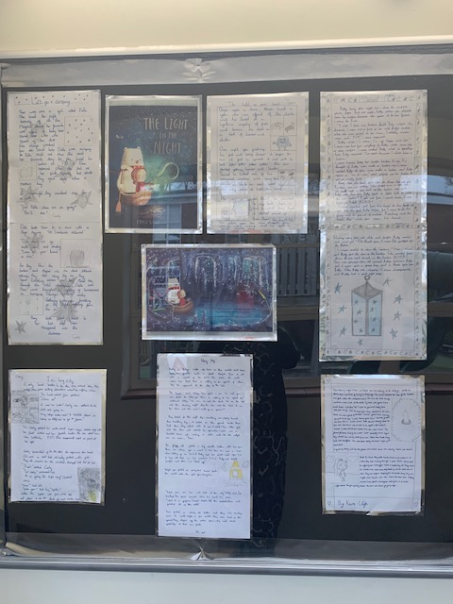
As a whole school English project work was based on ‘The Light in the Night’…

Slide 18
School Values
As a school we look in depth at ALL of the Christian Values through our Collective Worship.
In January 2020 the Worship Group were tasked with choosing specific values to represent the school from our vision statement and aims.

Slide 19
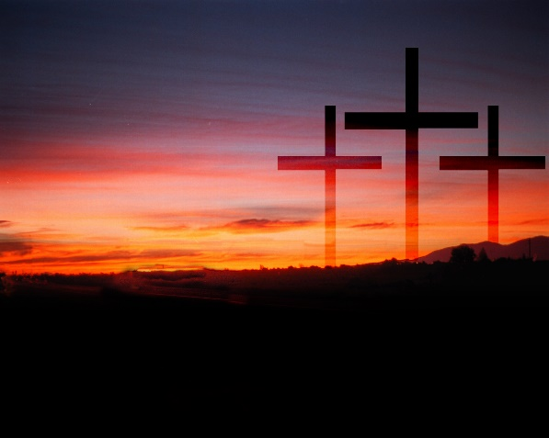
FORGIVENESS
For forgiveness and reconciliation in safe surroundings

Slide 20

LOVE
To seek experiences to spark the confidence to nurture and show delight

Slide 21
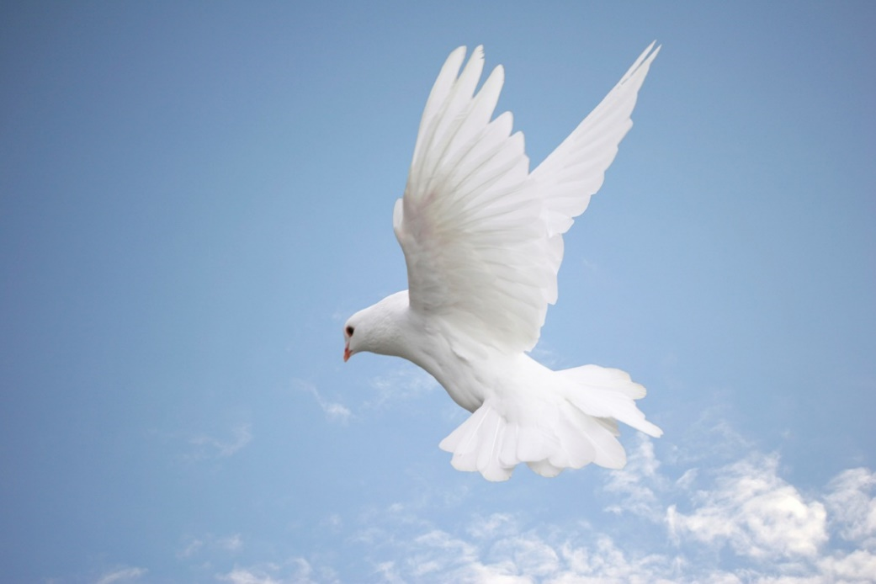
HOPE
To illuminate hopes, dreams and aspirations

Slide 22

FRIENDSHIP
To build humanity through relationships inspired by the glow of others

Slide 23
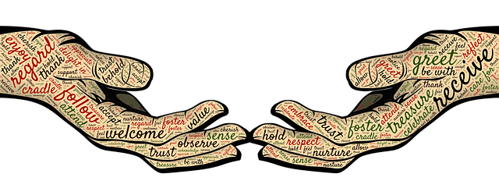
RESPECT
To value everyone through thoughts and actions

Slide 24
From September 2021 we linked Bible stories, Bible verses and songs to our school values
Value | Story | Verse | Song
Respect | The Centurion’s Servant | Matthew 7:12 | Nobody is a no-one
Hope | The healing of the leper | Jeremiah 29:11 | Lord of all hopefulness
Forgiveness | The unmerciful servant | Matthew 6:14-15 | I’m accepted, I’m forgiven
Friendship | The Good Samaritan | Ecclesiastes 4:9-10a | When I needed a neighbour
Love | The Prodigal Son | John 13:34 | Shine Jesus Shine
SHINE – This little light of mine.

